Slide 1
Rental Pricing Dataset in Kuala Lumpur
By Group 2 Members:
Uithiswary a/p Velan 1191202283 (Leader)
Liew Zhi Tong 1211203835
Priveeta Gobi Krishnan 1211204549
Yeo Hui Yi 1211201569

Slide 2
INTRODUCTION
The rental markets in Kuala Lumpur and Selangor face challenges such as a lack of transparency in pricing, inefficiencies in decision-making for tenants and landlords, and market price distortions. This project utilizes the "Rental Pricing Dataset, Malaysia" to analyze key factors influencing rental prices, including property type, location, and amenities. Python-based exploratory data analysis (EDA) and machine learning models such as Random Forest, Neural Networks, K-Means Clustering, and Gradient Boosting are employed to uncover patterns and provide actionable insights.
The project focuses on preparing the dataset by addressing missing values, outliers, and inconsistencies, followed by deriving insights through descriptive statistics and visualizations. Recommendations aim to support tenants in finding affordable housing, help landlords set competitive pricing, and assist policymakers in addressing urban housing affordability. Ultimately, the findings contribute to a fairer and more transparent rental market.

Slide 3
RELATED WORK
In our literature review we have gone through multiple different articles that demonstate prediction techniques and various outcomes within different geographic areas of our chosen rental price dataset with feature selection of property type or location or even amenities.
One of the articles talked about regression models while considering property type and location variables, another used ensemble learning methods to achieve accuracy rates of apartment sizes. Random forest models were analyzed and shown to be effective for accuracy for some and collectively these studies underline the importance of advanced machine learning models, feature selection, and regional characteristics in improving rental price prediction accuracy

Slide 4
DATASET
Dataset: Property rental listings in Kuala Lumpur & Selangor
Enables investigation of variable affecting rental prices & property preferences.
Total of 14 attributes: ads_id, prop_name, completion_year, monthly_rent, location, property_type, rooms, parking, bathroom, size, furnished, facilities, additional_facilities & region.
Offers significant insights into market trends & property preferences in Kuala Lumpur & Selangor by concentrating on important elements influence renting decisions.
Data Cleaning
Missing values (numerical): completion_year, parking & bathroom -> using median to preserve data consistency & reduce impact of outliers.
Missing values (categorical): prop_name, furnished & facilities -> using mode to maintain logical consistency throughout dataset.
Non-numeric characters removed from monthly_rent column, only numeric values remained & converted to integers. (e.g. RM4200 per month -> 4200)
Columns like size, rooms, bathroom & parking processed extract numeric values from text-based, ensuring data type consistency for analysis.

Slide 5
METHODOLOGY, EXPERIMENT AND ANALYSIS
Random forest
by Liew Zhi Tong
Neural Network
by Priveeta Gobi Krishnan
K-Means Clustering
by Yeo Hui Yi
Gradient Boosting
by Uithiswary a/p Velan

Slide 6
RANDOM FOREST - CLASSIFICATION
The Random Forest algorithm was used to classify rental prices into five predefined categories. The methodology involved the following steps:
Data Preprocessing:
Converted non-numeric columns (e.g., size, rooms, parking) into integers.
Handled missing values using the median.
Applied one-hot encoding to categorical variables.
Binned the target variable, "monthly_rent," into five categories.
Model Setup:
Split data into 80-20 train-test sets.
Trained the model with 100 decision trees.
Used ensemble learning to reduce overfitting.
Evaluation Metrics:
Confusion Matrix, Classification Report, and Accuracy Score were used to assess performance.
Insights and Strengths:
Feature Importance Analysis revealed key factors influencing rental prices.
Efficiently handles high-dimensional data while providing interpretable results.

Slide 7
RANDOM FOREST - EXPERIMENTAL SETUP
The Random Forest classifier analyzed rental prices in Kuala Lumpur using apartment characteristics. The dataset was preprocessed and divided into categories for better classification.
Target Variable (monthly_rent) categorized into 5 classes:
Class 0: Below RM1500
Class 1: RM1500–RM3000
Class 2: RM3000–RM4500
Class 3: RM4500–RM6000
Class 4: Above RM6000
Data Preparation:
Handled missing values and encoded categorical variables.
Stratified sampling used to maintain class proportions.
Model Setup:
Data split into 80% training and 20% testing.
Conducted Grid Search to tune hyperparameters across 108 combinations:
n_estimators: [50, 100, 200]
max_depth: [None, 10, 20, 30]
min_samples_split: [2, 5, 10]
min_samples_leaf: [1, 2, 4]

Slide 8
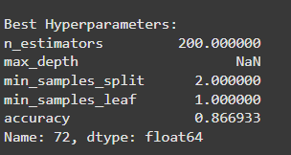
RANDOM FOREST - HYPERPARAMETER TUNING RESULTS
Grid Search identified the best-performing model with high accuracy and optimized parameters.
Top-Performing Model:
Accuracy: 86.69% on test data
Optimal Hyperparameters:
n_estimators: 200
max_depth: None
min_samples_split: 2
min_samples_leaf: 1
Insights from Hyperparameter Tuning:
Higher accuracy achieved with:
Larger number of estimators (n_estimators)
Deeper tree structures (max_depth: None)
Demonstrates that a complex model is better suited for this dataset.

Slide 9
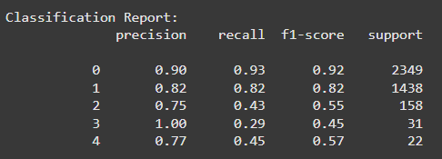
EVALUATION OF RANDOM FOREST MODEL FOR RENTAL PRICE CATEGORIES
Accuracy: Achieved 86.69% on the test set
Strong Performance:
Category 0 (Rentals below RM1500): Precision = 0.90, Recall = 0.93
Category 1 (Rentals between RM1500 and RM3000): Precision = 0.82, Recall = 0.82
Challenges with Rare Categories:
Category 2 (RM3000 to RM4500): Precision = 0.75, Recall = 0.43, F1-score = 0.55
Categories 3 and 4: High precision but low recall due to class imbalance

Slide 10
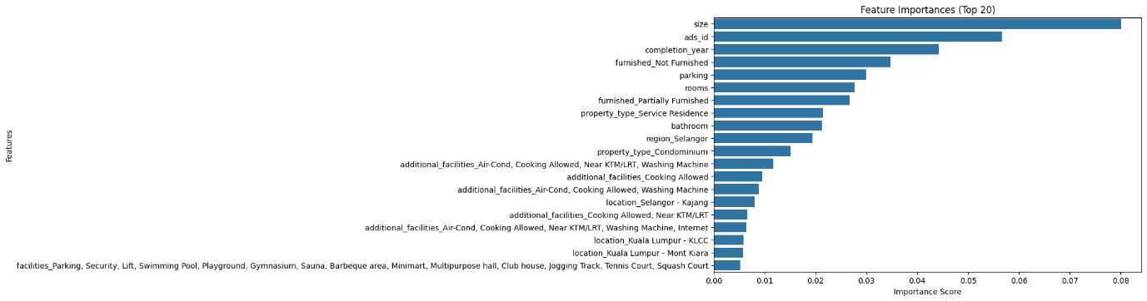
RANDOM FOREST - KEY FEATURES & INSIGHTS FOR RENTAL PRICE PREDICTION
Top Predictive Features:
Apartment Size, Completion Year, Number of Rooms
Building Size and Construction Date
Bathrooms & Parking Spaces
Analysis Insights:
Physical characteristics (size, age, room count) are pivotal in rental price prediction.
Location-based factors also play a significant role.
Predictive models perform well for frequent rental price categories but require refinement for less common price categories.

Slide 11
RANDOM FOREST - FUTURE MODEL IMPROVEMENTS & INDUSTRY APPLICATIONS
Key Improvements Needed:
Address Class Imbalance: Techniques like SMOTE, oversampling, and cost-sensitive learning can help improve performance for minority classes.
Enhance Model with Hybrid Approaches: Combining ensemble methods and hybrid algorithms can improve predictions for less frequent rental categories.
Practical Applications:
Real Estate Market Strategies: Insights from feature importance analysis can guide stakeholders in optimizing pricing strategies based on apartment size, age, and room count.
Improved Prediction Accuracy: Addressing class imbalance and implementing advanced techniques will lead to more accurate predictions across all rental categories, boosting the model's practical applicability in the real estate industry.

Slide 12





NEURAL NETWORK - EXPERIMENT
MSE is very high, performance and predictions have a larger variance
R2 Score for 1st Epoch 38 = 0.0029
R2 Score for Mid Epoch 51 = 0.0029
R2 Score for Last Epoch 100 = 0.0029
The overall score is only 0.0029, relatively close to 0

Slide 13
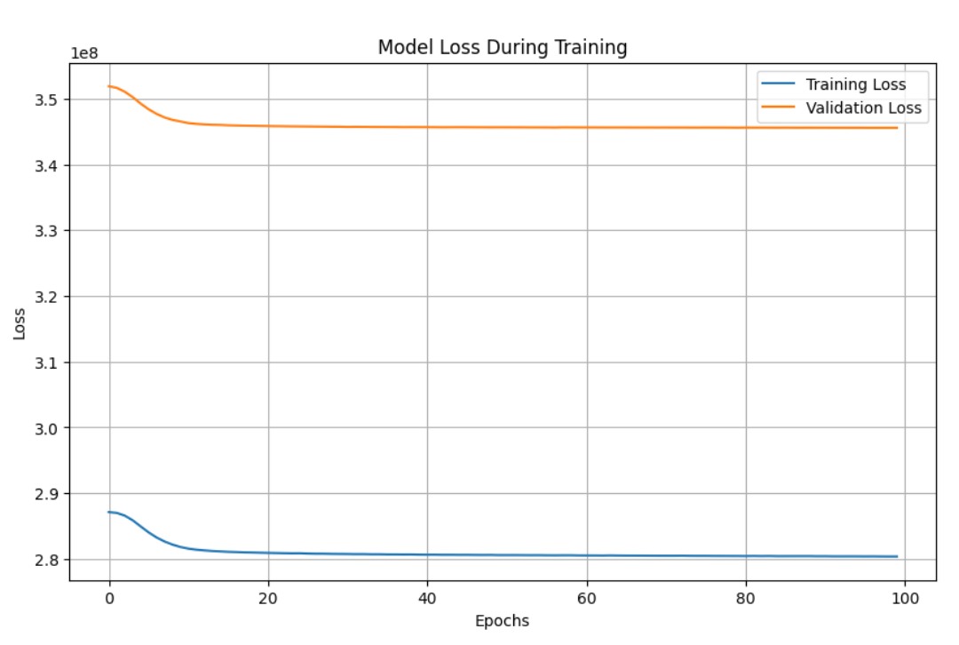
NEURAL NETWORK - ANALYSIS
x-axis is the epochs numbers
y-axis is the number of losses
Training loss line in blue line represents how well the model fits the data it was trained on,
Validation loss line in orange measures how well the model generalizes
(avoiding overfitting).
Both the curves start from a high loss value of about 3.5
Both losses decrease steadily and reach approximately 2.8 by the 100th epoch.

Slide 14
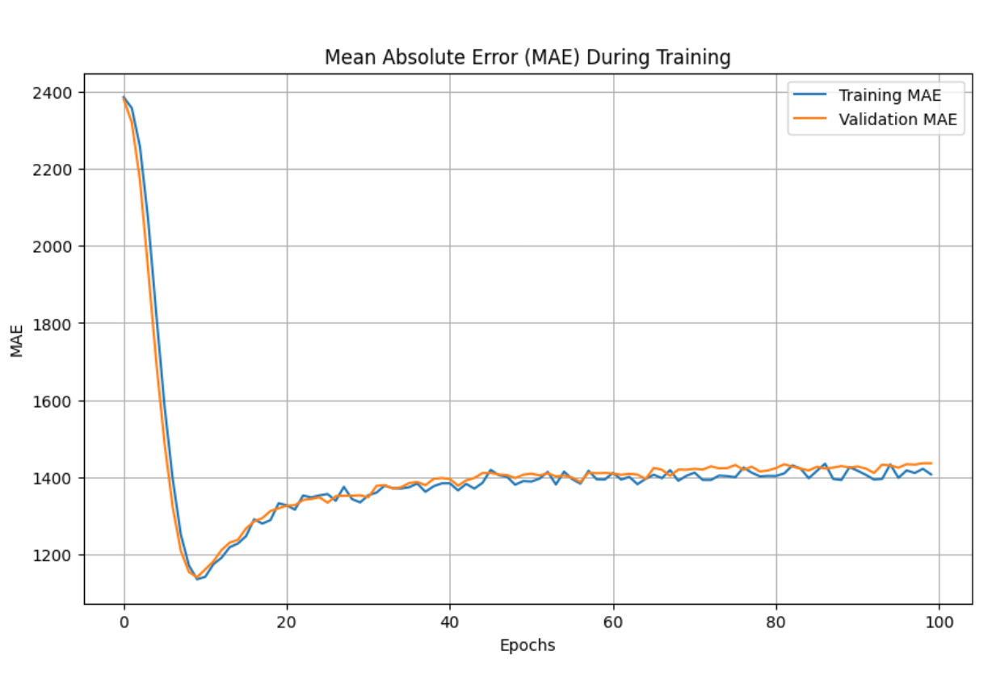
NEURAL NETWORK
x-axis is the epochs numbers
y-axis value measures the avg. mean absolute value differences
Starting point =2400, learning period is 20 epochs
Stability = 1400, plateau
Maximum performance at 1400

Slide 15
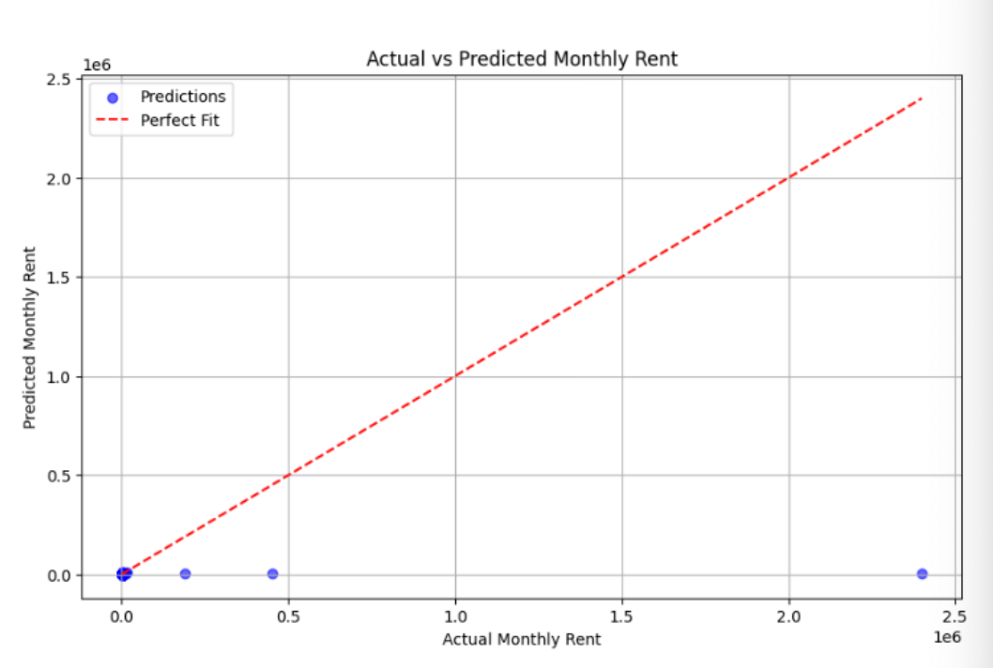
NEURAL NETWORK
Overfitting
This scatter plot has a wide spread of points away from the ideal “Perfect fit” line that signifies inaccurate predictions
This poor generalization is unreliable for our chosen dataset on rental pricing

Slide 16
K-MEANS CLUSTERING - METHODOLOGY
Features: monthly_rent, size, rooms, bathroom & parking -> cleaned & converted to integer for analysis
All features have been standardized using StandardScaler.
Spilt dataset into training & testing sets -> 80:20 ratio.
Models trained with K values range from 2 to 10.
Elbow Method: finds where the curve of inertia starts to flatten
Silhouette Scores: evaluate how well K-Means clustering results are
R-squared accuracy: compute to measure how many variances in the data explained by the cluster centres.

Slide 17
K-MEANS CLUSTERING - EXPERIMENT
*k -> Number of clusters
First Model (k=3)
Low accuracy shows that 3 clusters are not enough to show the dataset structure.
Best Model (k=10)
10 cluster are better fit for data, explaining more variance & capturing more fine-grained patterns.
Intermediate Model (k=6)
Slightly lower than the best model highlights that 6 clusters are still suboptimal for this dataset.

Slide 18
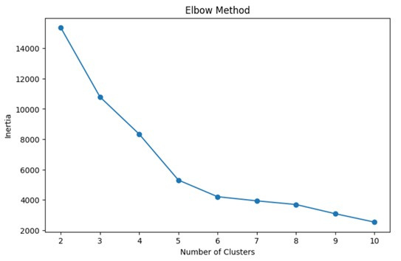
K-MEANS CLUSTERING - EVALUATION 1
*k -> Number of clusters
Relationship between no. of clusters (k) and inertia -> measure cluster compactness.
Inertia drop in sharp decline from k=2 to k=4
At k=4 / k=5, slope of reduction rate drops more significantly, shows elbow point & might be optimal no. of clusters in dataset.
Elbow Method

Slide 19
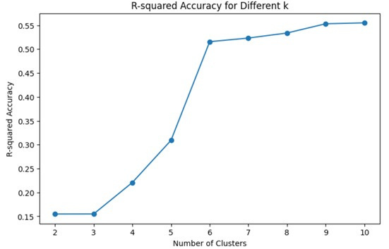
K-MEANS CLUSTERING - EVALUATION 2
*k -> Number of clusters
Performance of K-Means Clustering varies with no. of clusters (k).
Observed from plot that R-squared accuracy increases, reaching it max value at 0.5551 for k=10.
10 clusters are the best to describe most variance in data.
Various evaluation metrics must be considered in choosing optimal value of k as this result inconsistent with Elbow Method where optimal either at k=4 / k=5.
R-squared Accuracy for Different k

Slide 20
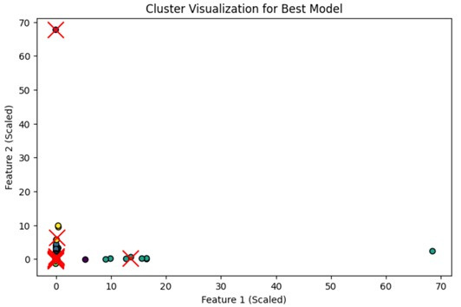
K-MEANS CLUSTERING - EVALUATION 3
*k -> Number of clusters
Best model k=10 splits data into 10 distinct clusters represented using different colours.
Red ‘X’ markers outline centroids for every cluster, central point around data point collected.
Most clusters are separated.
High R-squared accuracy, 0.5551, realized by model & supports fact that clusters captured important data patterns.
Cluster Visualization for Best Model

Slide 21
GRADIENT BOOSTING -METHODOLOGY
Gradient Boosting algorithm is an ensemble learning technique that builds models sequentially to correct errors.
Objective: predict rental prices using Gradient Boosting algorithm
Data Preprocessing:
Handling Missing Values:
Numeric columns (e.g., completion_year, parking, bathroom) were imputed using the median to reduce the impact of outliers.
Categorical columns (e.g., prop_name, furnished, facilities) were filled with the mode to maintain logical consistency.
Data Cleaning:
Non-numeric characters were removed from columns like monthly_rent, and values were converted to integers.
Text-based entries in columns like size, rooms, bathroom, and parking were processed to extract numeric values.
Feature Engineering:
Categorical variables were converted into numerical format using one-hot encoding and label encoding.
Feature scaling was applied to normalize the data, ensuring all features contribute proportionately to the model.
Dataset Split:
80% training set, 20% testing set.
Model Initialization:
Key hyperparameters:
Number of boosting rounds (n_estimators).
Learning rate.
Maximum depth of trees (max_depth).
Minimum samples to split a node (min_samples_split).
Subsample ratio (subsample).

Slide 22

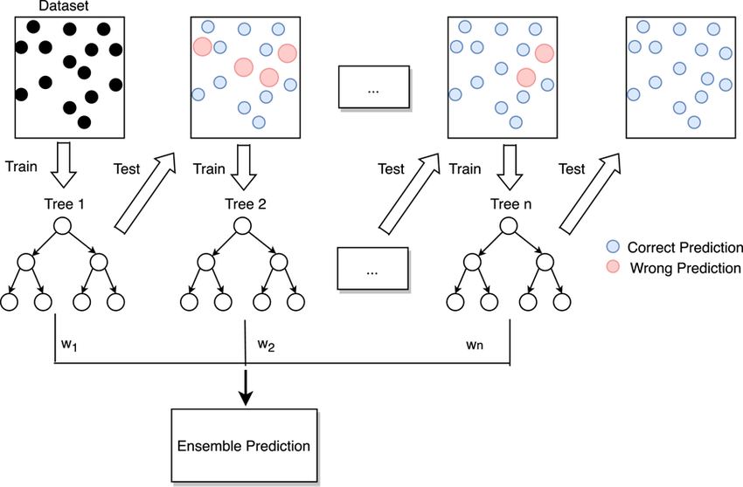
GRADIENT BOOSTING -METHODOLOGY
Training Process:
Sequential integration of decision trees.
Each new tree corrects errors from the previous one.
Iteration continues until satisfactory performance or stopping criteria are met.
Performance Monitoring:
Metrics: Mean Squared Error (MSE), Root Mean Squared Error (RMSE), R-squared.
Cross-validation (k-fold) to prevent overfitting.
Example of Gradient Boosting algorithm

Slide 23
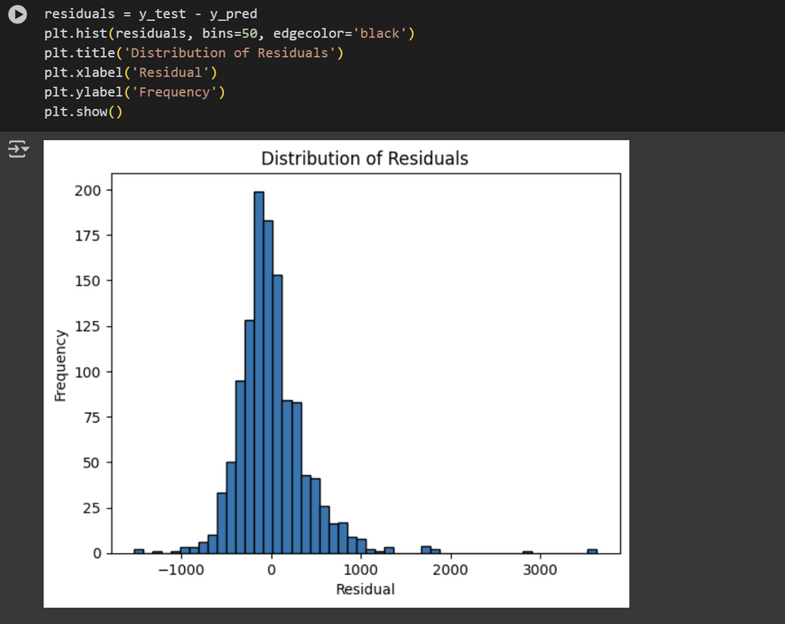
GRADIENT BOOSTING - EXPERIMENT
Tested Combination:
Learning rate: (0.01, 0.1, 0.2),
n_estimators: [50, 100, 200],
max_depth: [3, 5, 7],
min_samples_split: [2, 5, 10],
subsample: [0.8, 1.0],
Best Configuration:
Learning rate: 0.1 or 0.2.
Number of estimators: 200.
Maximum depth: 7.
Minimum samples to split: 2.
Subsample ratio: 1.0
Performance Metrics:
R-squared: 0.72
The model explains 72% of the variance in rental prices, indicating a strong fit to the data.
This high R-squared value suggests that the model captures the key factors influencing rental prices effectively.
RMSE (398.27):
The low RMSE value indicates that the model's predictions are close to the actual rental prices on average.
Residual Analysis: The residuals were symmetrically distributed around zero, showing that the model's predictions were unbiased, though some outliers were present.

Slide 24
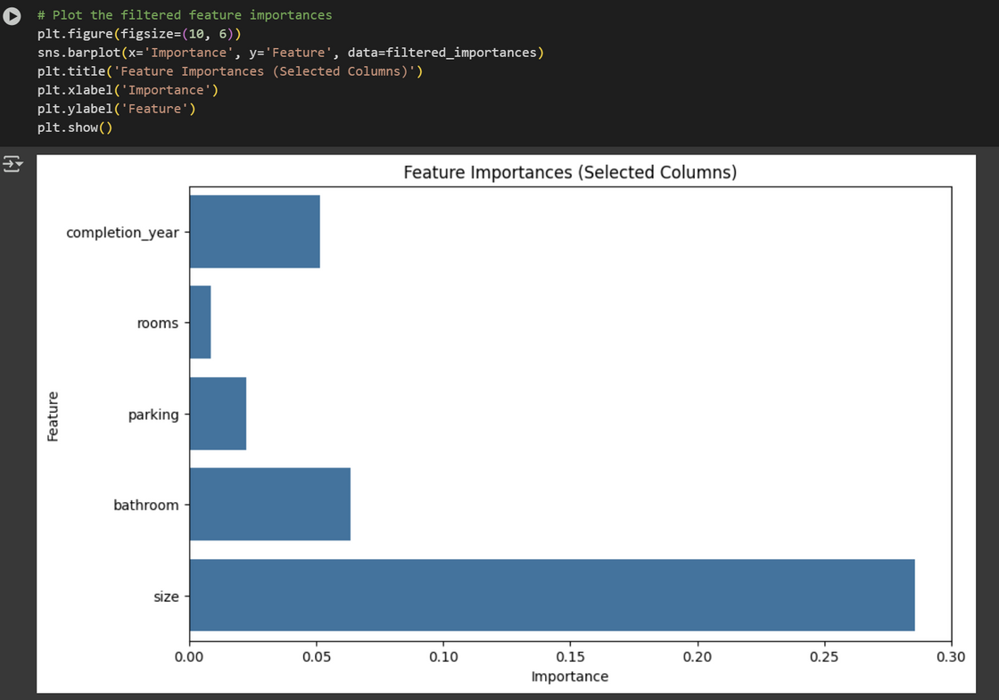
GRADIENT BOOSTING - ANALYSIS
Feature Importance is to identify which features have the most significant impact on the model's predictions.
Top Features:
Property Size (0.285732): The most influential feature, indicating that larger properties tend to have higher rental prices.
Number of Bathrooms (0.063706): The second most important feature, suggesting that properties with more bathrooms are more desirable and command higher rents.
Completion Year (0.045): Newer properties tend to have higher rental prices, as they are often more modern and better maintained.
Number of Parking Spaces (0.035): Properties with more parking spaces are more attractive to tenants, especially in urban areas.
Number of Rooms (0.030): While still significant, the number of rooms has a smaller impact compared to property size and bathrooms.
Insights:
The analysis reveals that physical characteristics of the property (e.g., size, number of bathrooms) are the most critical factors in determining rental prices.
Location-based factors (e.g., completion year, parking) also play a role but are less influential than property size and bathrooms.

Slide 25
DISCUSSION
Model Performance Metrics:
R-squared (0.72):
The model explains 72% of the variance in rental prices, indicating a strong fit to the data.
This high R-squared value suggests that the model captures the key factors influencing rental prices effectively.
RMSE (398.27):
The low RMSE value indicates that the model's predictions are close to the actual rental prices on average.
This metric confirms the model's accuracy and reliability for real-world applications.
Comparison with Other Models:
The Gradient Boosting model outperformed other models like Neural Networks, K-Means Clustering, Random Forest in terms of both R-squared and RMSE.
Neural Networks: Performed poorly due to its inability to learn meaningful patterns (R-squared: 0.0029), likely due to insufficient data or hyperparameter tuning.
K-Means Clustering: Effective for grouping similar properties but less suitable for price prediction (best R-squared: 0.5551).
Random Forest: Achieved good accuracy (86.69%) for frequent rental categories but struggled with imbalanced data and less common rental types.
Better than Random Forest in handling class imbalance and predicting continuous rental prices.
The Gradient Boosting model's ability to handle complex, non-linear relationships in the data made it the best-performing model for this dataset.

Slide 26
CONCLUSION
Model Performance: The Gradient Boosting model emerged as the most reliable predictor of rental prices in Kuala Lumpur/Selangor, achieving an R² of 0.72 and RMSE of 398.27.
Feature Importance:
The model provides clear insights into which features drive rental prices, making it highly interpretable.
This interpretability is valuable for stakeholders who need to understand the factors influencing rental prices.
Critical Price Factor: Property size, completion year, and number of bathrooms were identified as the most influential factors, aligning with real-world expectations.
Actionable Insights:
Landlords: Can use the model to optimize rental pricing strategies by focusing on key features like property size and number of bathrooms.
Tenants: Can identify affordable housing options by targeting properties with smaller sizes or fewer amenities.
Policymakers: Can use the model's insights to develop policies that promote affordable housing in urban areas.
The project successfully addressed its goals of identifying rental price determinants and delivering a predictive tool to bridge information gaps in the market.

Slide 27
THANK YOU

